Slide 1
Image to Text in Natural Language Processing
Joyce Woznica IST 664 (Tuesday 6:00 PM)

Slide 2
What is Image to Text?
The simplest way to describe Image to Text is to review Recognition:
Optical Character Recognition (OCR)
OCR converts pixels on a page into digital form that is then recognized by a computer and can be converted to individual letters, words, numbers, etc.
Optical Mark Recognition (OMR)
This converts marks in a particular location on a page (like filling in the black box for Yes/No) and records it as a value
Intelligent Character Recognition (ICR)
This is also the term used for recognizing handwriting which can be more complex because of how individual print or use cursive

Slide 3
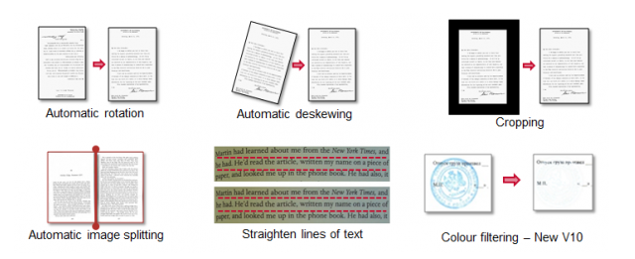
Processing Steps for Recognition
Input
Read the input file(s)
On disk, from a scanner, from an Xray, from an image, etc.
PreProcessing
Remove noise Despeckle (remove specks on the page)
Deskew: Straighten alignment of page
Cropping: eliminate extra white space
Recognition
Look for words, letters, numbers, etc.
Verification
Allow users to verify when there is a question like . . .
is it an “O” or a “0” or a “Q”

Slide 4
Strong Engines for doing Recognition
Historical Strong Players
ABBYY Finereader - https://abbyy.technology/en:start
Tesseract - https://opensource.google/projects/tesseract
OmniPage Ultimate - https://www.kofax.com/Products/omnipage
New Players
Amazon Textract - https://aws.amazon.com/textract/
Adobe Acrobat - https://acrobat.adobe.com/us/en/acrobat/how-to/ocr-software-convert-pdf-to-text.html
Amazon Recognition - https://aws.amazon.com/rekognition/
There are so many more - some free, some very costly

Slide 5
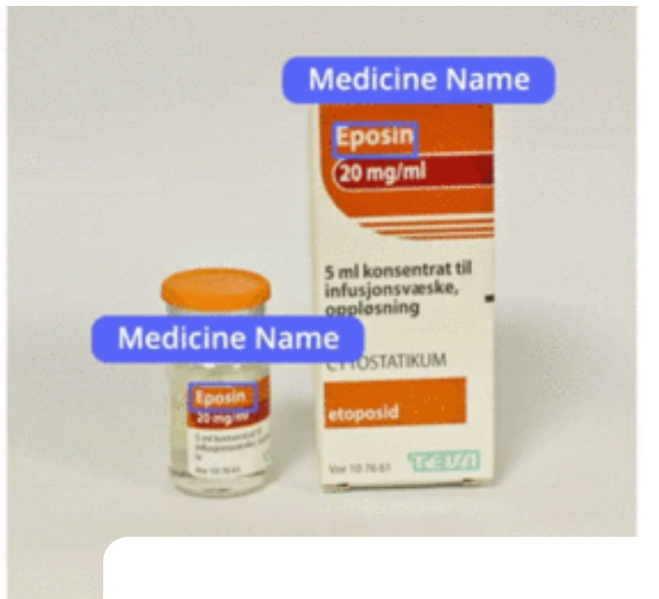
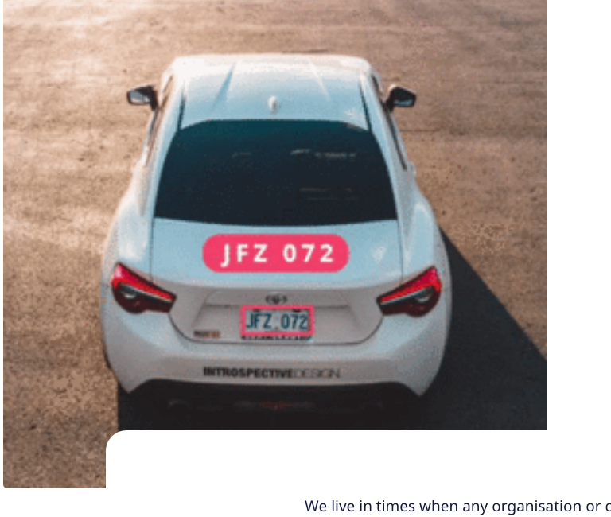
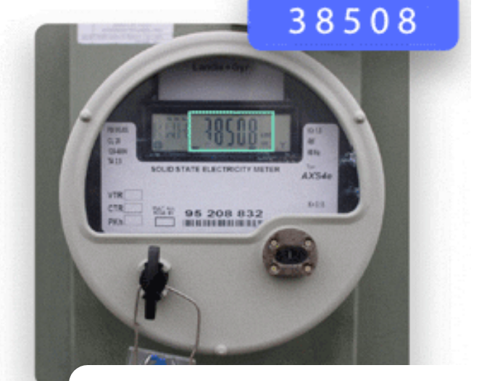
Not just Paper Anymore
Can be used in law enforcement to read plates
Already used at toll booths
Can be used to provide intelligence to photographs and images
You can extract entitles like company names or drug name
Can help to categorize content
Can be used to show relationships
White car to plate number

Slide 6
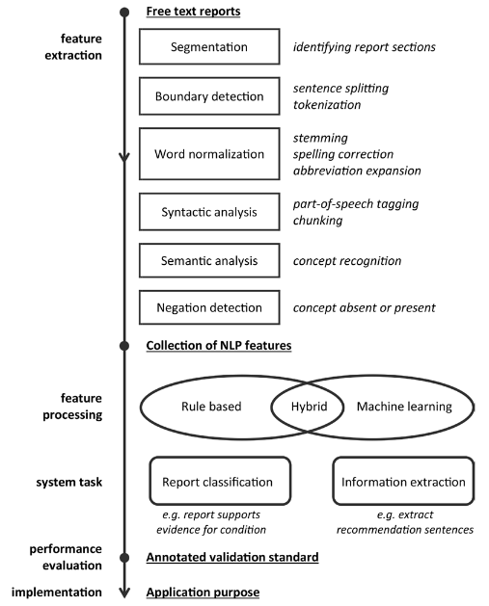
But how does this apply to NLP?
Image to Text platforms are getting smarter
First you apply Optical Character Recognition - then
You can now detect, understand and classify blocks of text to extract meaning
They have learning modules so they can be trained
Classification based on document structure, words in the documents (invoice, purchase order, etc) can be used to classify appropriate
Analysis example (Xray or Medical Test Reading)
Checking for information in thresholds (high counts/low counts, etc.)
This can be used to automatically notify a patient/doctor of an issue
Helps to ascertain next steps or validate treatment or more

Slide 7
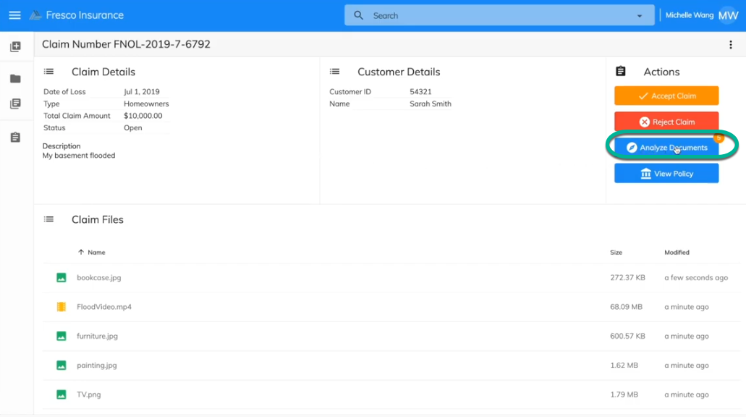
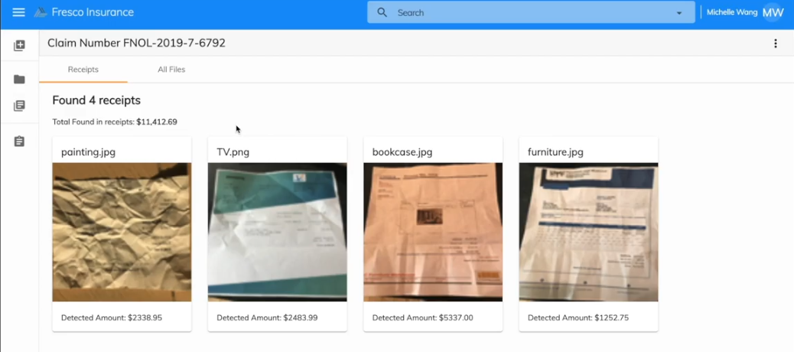
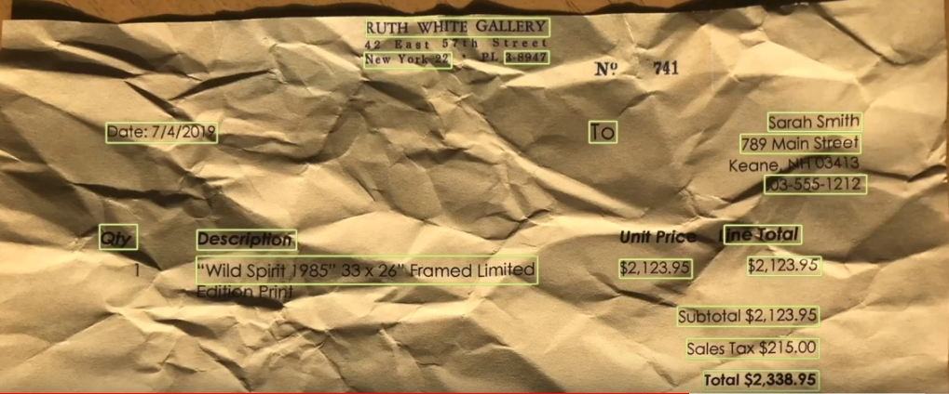
Use Case - Claims Processing
Using Amazon Textract and Alfresco Content and Process Services to streamline triaging a claim:
https://www.youtube.com/watch?v=s7iQG-jiLnw - Overview
Using image to text to upload information in to a system
https://www.youtube.com/watch?v=8gAwYv3dLvs - Demonstration
In this demonstration:
Analyze Documents:
Classification is used to determine the type of document uploaded
Image to text is used to add claimed loss costs and verification

Slide 8
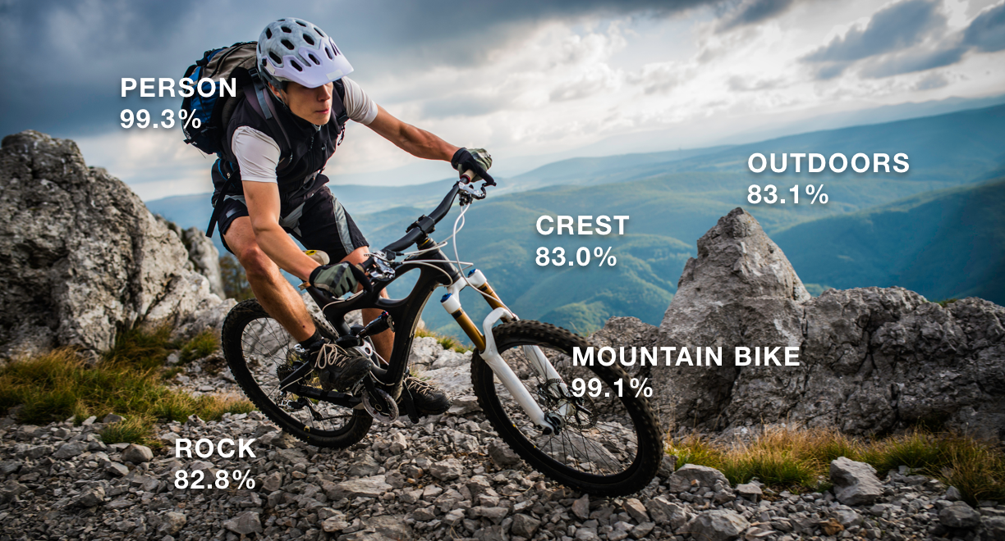
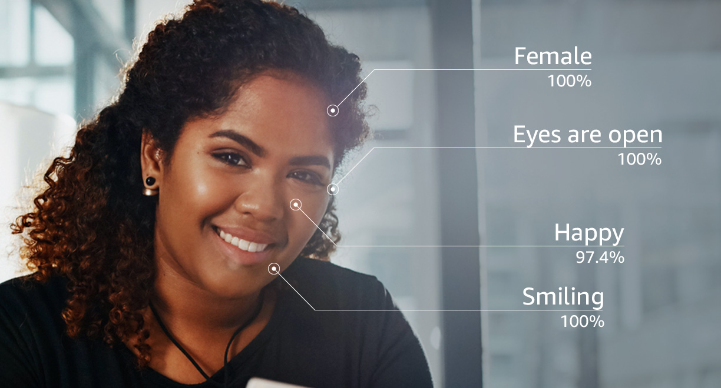
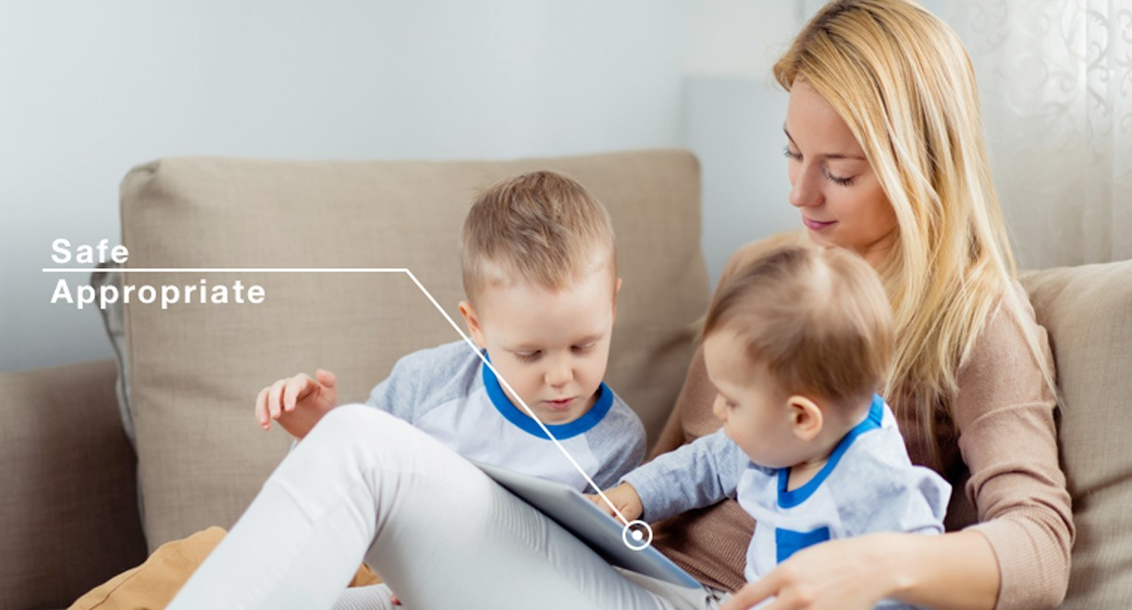

Where are we heading?
Artificial Intelligence with Machine Learning
With companies like Amazon and their product Amazon Rekognition, we can now recognize:
People
Places
Objects
Sentiment
And more
This type of technology is already being used by customers like those below

Slide 9
References
ABBYY Technology Portal: https://abbyy.technology/en:features:ocr:processing-steps
Adobe: https://acrobat.adobe.com/us/en/acrobat/how-to/ocr-software-convert-pdf-to-text.html
Alfresco: http://www.alfresco.com
Amazon Rekognition: https://pubs.rsna.org/doi/pdf/10.1148/radiol.16142770
Amazon Textract: https://aws.amazon.com/textract/
Best OCR Engines: https://beebom.com/best-ocr-software/
clarifai: https://www.clarifai.com/blog/nlp
Deep Learning and OCR: https://nanonets.com/blog/deep-learning-ocr/
Google Tessearct OCR: https://opensource.google/projects/tesseract
Natural Language Processing in Radilogy: https://pubs.rsna.org/doi/pdf/10.1148/radiol.16142770
RSNA Radiology: https://pubs.rsna.org/doi/10.1148/radiol.16142770

